Slide 1

Project Title:Kidney Disease Prediction using Machine Learning Domain: Healthcare
First Review
Course Code: CS7510
Course Title: Project 1
Register Number:23MSP3090
Name:Deepika.G
Date:23.02.2024

Slide 2
Problem Statement
Predicting kidney disease using machine learning models to analyze patient data, aiding in early diagnosis and treatment.
Utilizing clinical attributes such as age, blood pressure, and biochemical markers to build predictive models. Objective: Improve healthcare outcomes by identifying individuals at risk of kidney disease progression.
Employing algorithms to classify patients into disease categories for targeted interventions and monitoring

Slide 3
Objectives
Develop accurate predictive models leveraging patient data to diagnose kidney disease at an early stage.
Enhance patient outcomes by identifying risk factors and patterns associated with kidney disease progression.
Employ machine learning algorithms to assist healthcare professionals in making timely and informed clinical decisions.
Improve patient care through personalized treatment plans and targeted interventions based on predictive analytics.
Foster proactive healthcare management strategies aimed at reducing the burden of kidney disease and optimizing patient well-being.

Slide 4
Review of Related Literature
Base Paper : Chronic Kidney Disease Prediction Using Robust Approach in Machine Learning
Author Name, Title of the Paper, Journal Title, Year of Publication:
Anurag, N. Vyas, V. Sharma and D. Balla, "Chronic Kidney Disease Prediction Using Robust Approach in Machine Learning," 2023 3rd International Conference on Innovative Sustainable Computational Technologies (CISCT), Dehradun, India, 2023, pp. 1-5, doi: 10.1109/CISCT57197.2023.10351277.
Methodology used: Machine Learning models are used to predict
Outcomes: accuracy, precision, recall, f1-score
Point taken into consideration for your methodology: Building ML Models with good accuracy

Slide 5
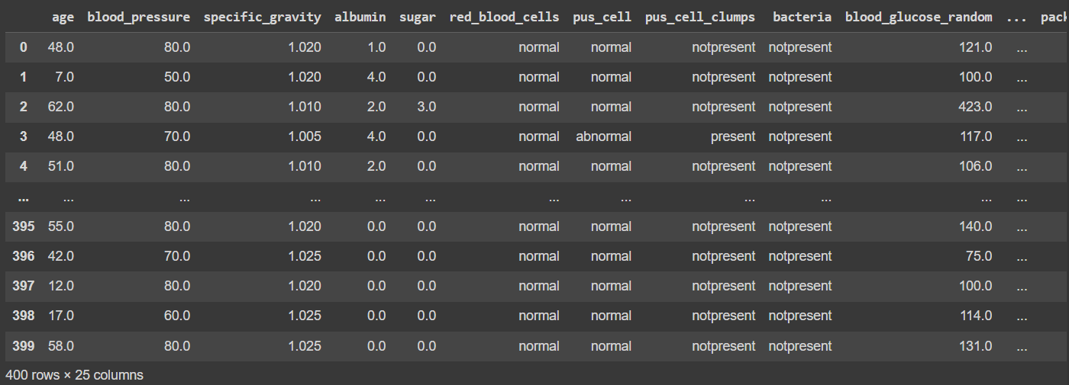
Dataset
Source of the Dataset: Chronic Kidney Disease Prediction (kaggle.com)
No. of Observations: Rows - 400, Columns - 26
Screenshot of the dataset:

Slide 6
Dataset
Column/Feature Details:
age : Patient's age.
id: Unique identifier for each patient.
blood pressure: Blood pressure measurement.
specific gravity: Specific gravity of urine.
albumin: Presence of albumin in urine.
sugar: Presence of sugar in urine.
red blood cells: Presence of red blood cells in urine.
pus cell: Presence of pus cells in urine.
pus cell clumps: Presence of pus cell clumps in urine.
bacteria: Presence of bacteria in urine.
blood glucose random: Random blood glucose measurement.
blood urea: Blood urea nitrogen level.

Slide 7
Dataset
serum creatinine: Serum creatinine level.
sodium: Sodium level in blood.
potassium: Potassium level in blood.
haemoglobin: Hemoglobin level in blood.
packed cell volume: Packed cell volume in blood.
white blood cell count: White blood cell count.
red blood cell count: Red blood cell count.
hypertension: Presence of hypertension.
diabetes mellitus: Presence of diabetes mellitus.
coronary artery disease: Presence of coronary artery disease.
appetite: Assessment of appetite.
peda edema: Presence of pedal edema.
aanemia: Presence of anemia.
class: Diagnosis of kidney disease (target variable).

Slide 8
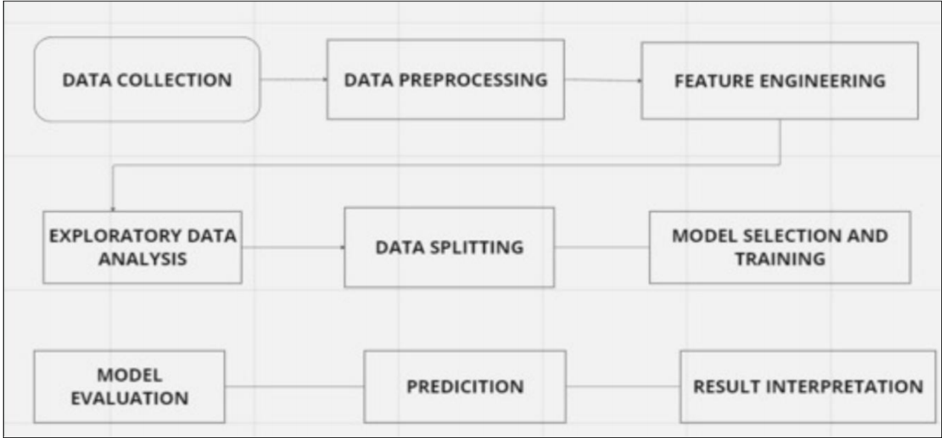
Proposed Methodology
Architecture Diagram

Slide 9
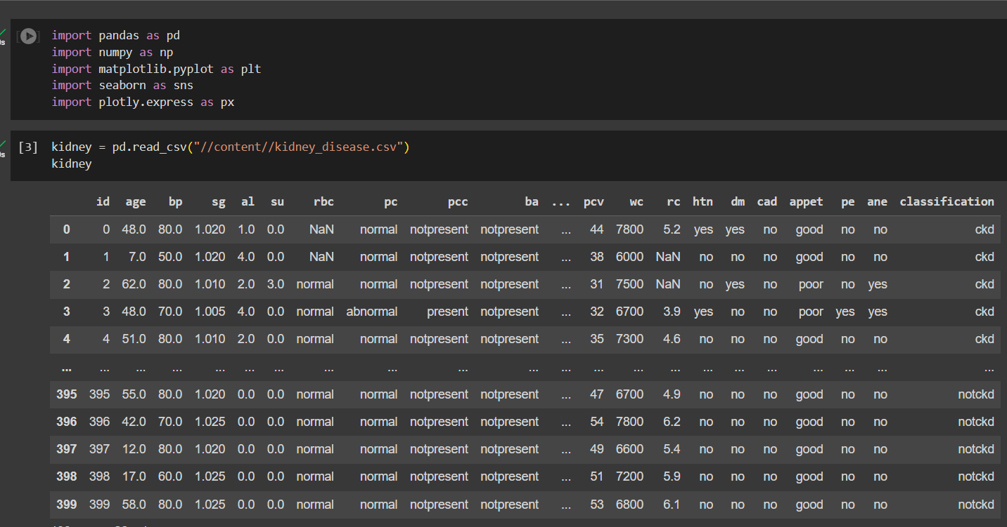
Exploratory Data Analysis

Slide 10
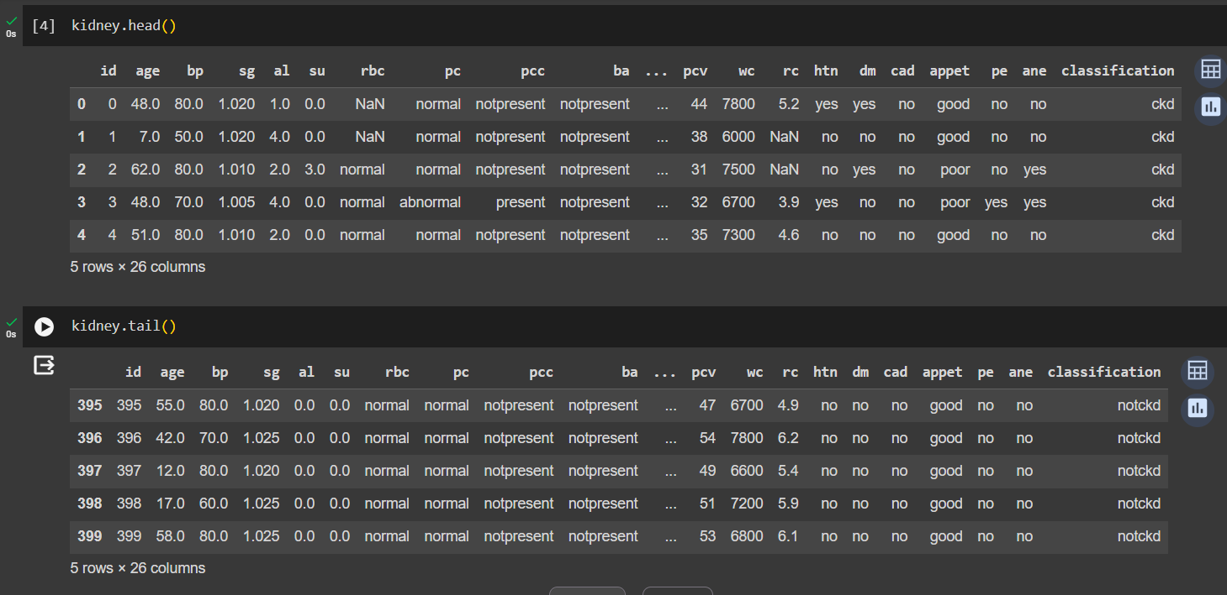
Exploratory Data Analysis

Slide 11
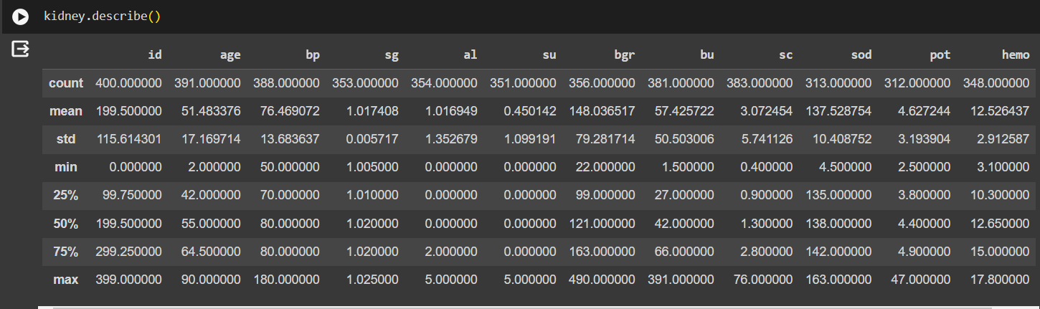
Exploratory Data Analysis

Slide 12
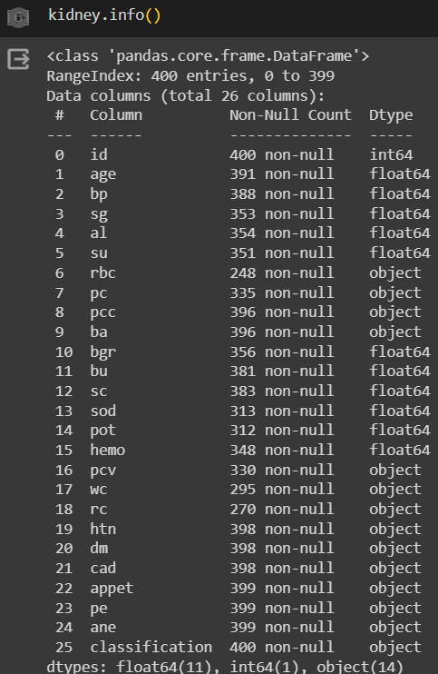
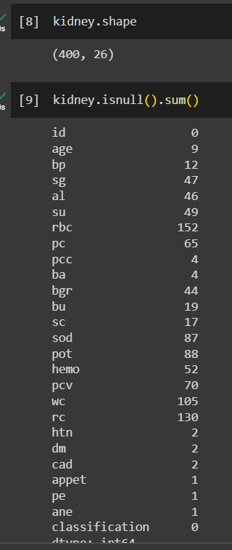
Exploratory Data Analysis

Slide 13
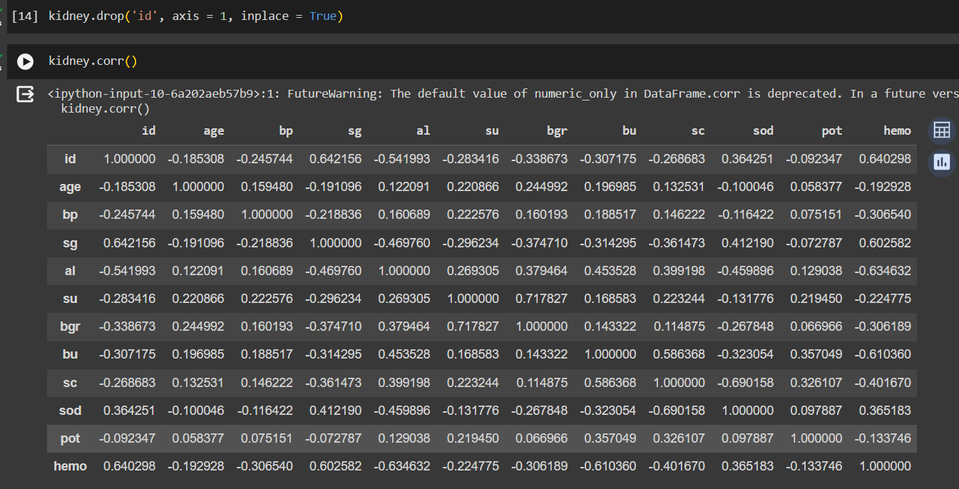
Exploratory Data Analysis

Slide 14
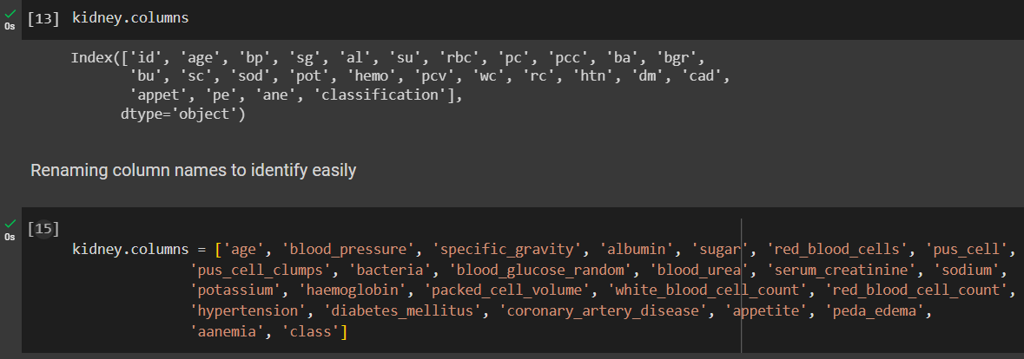
Exploratory Data Analysis

Slide 15
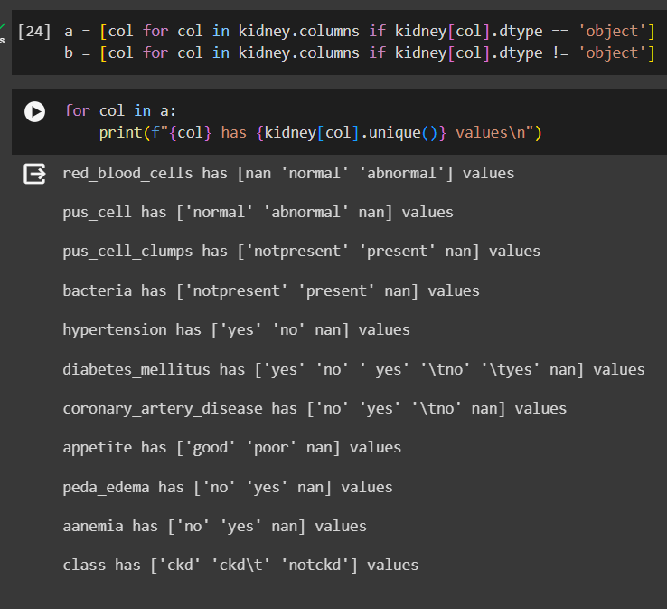
Exploratory Data Analysis

Slide 16
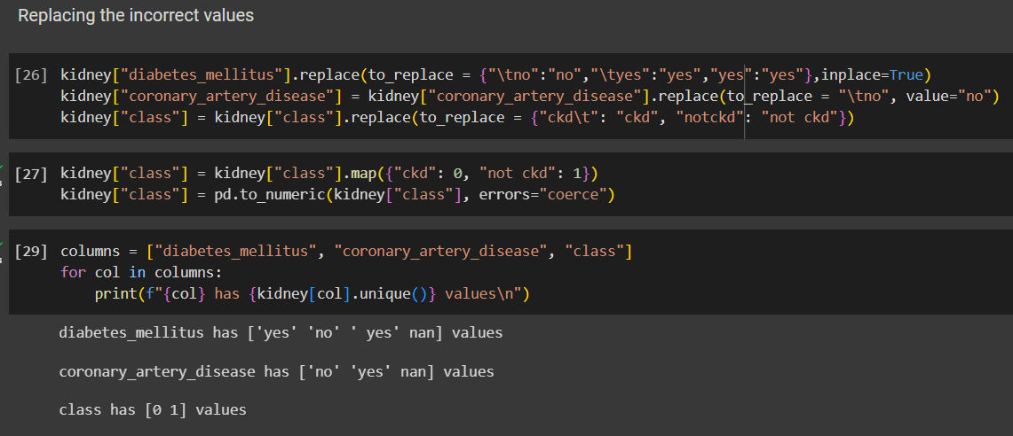
Exploratory Data Analysis

Slide 17
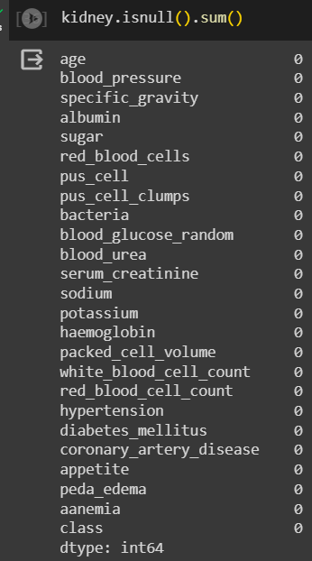
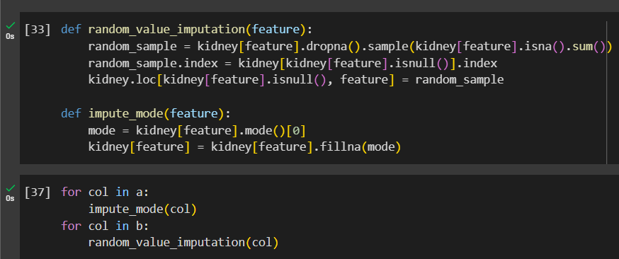
Exploratory Data Analysis

Slide 18
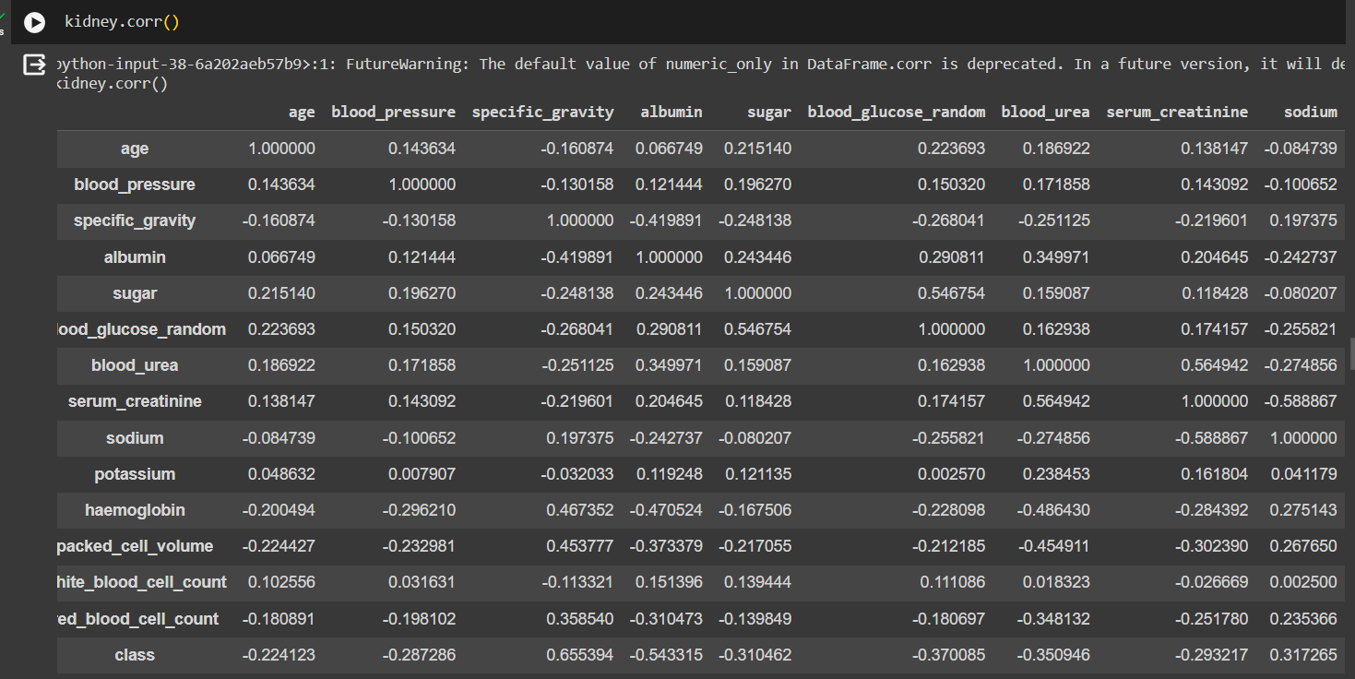
Exploratory Data Analysis

Slide 19
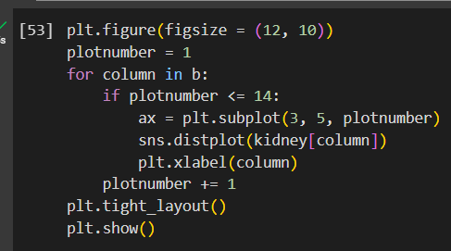
Exploratory Data Analysis

Slide 20
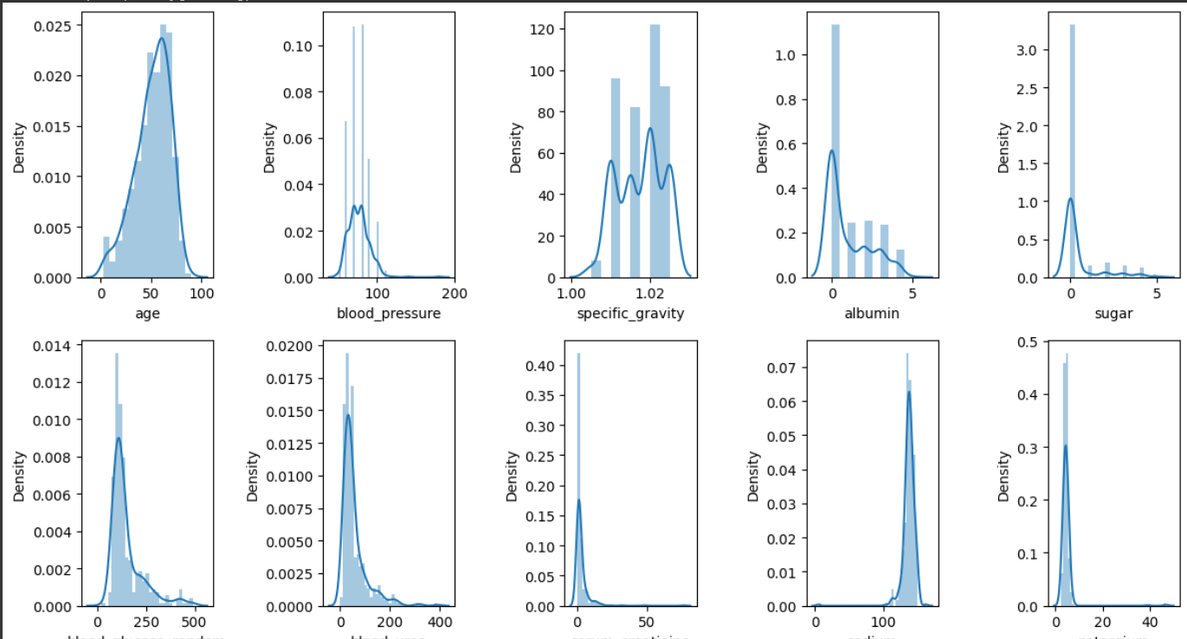
Exploratory Data Analysis

Slide 21
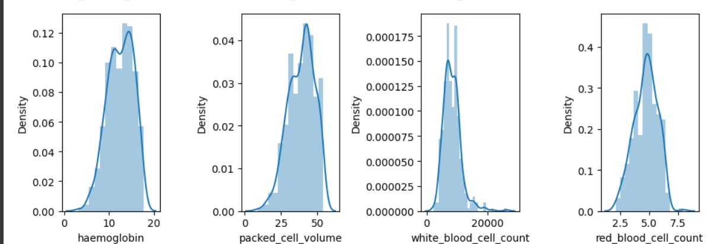
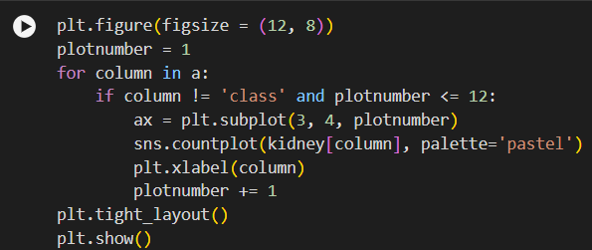
Exploratory Data Analysis

Slide 22
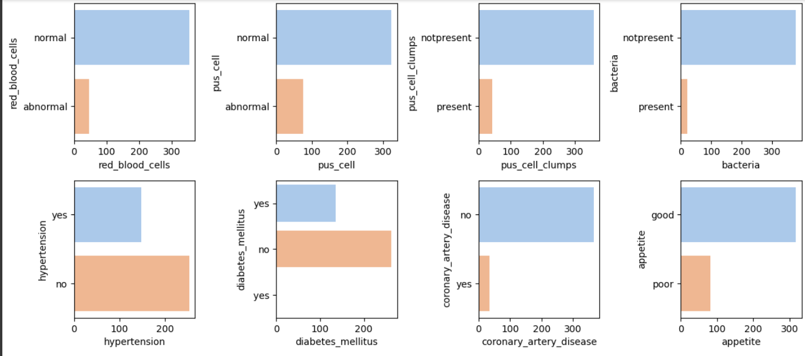
Exploratory Data Analysis

Slide 23
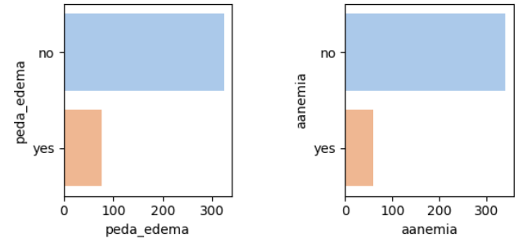
Exploratory Data Analysis

Slide 24
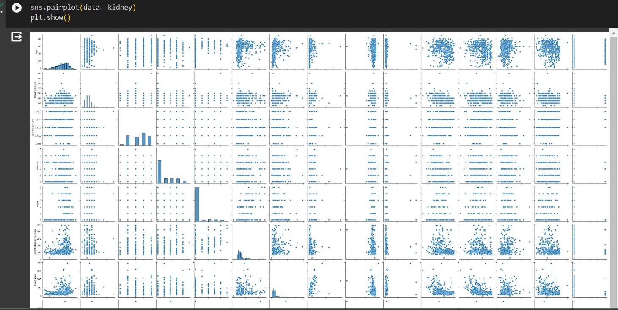
Exploratory Data Analysis

Slide 25
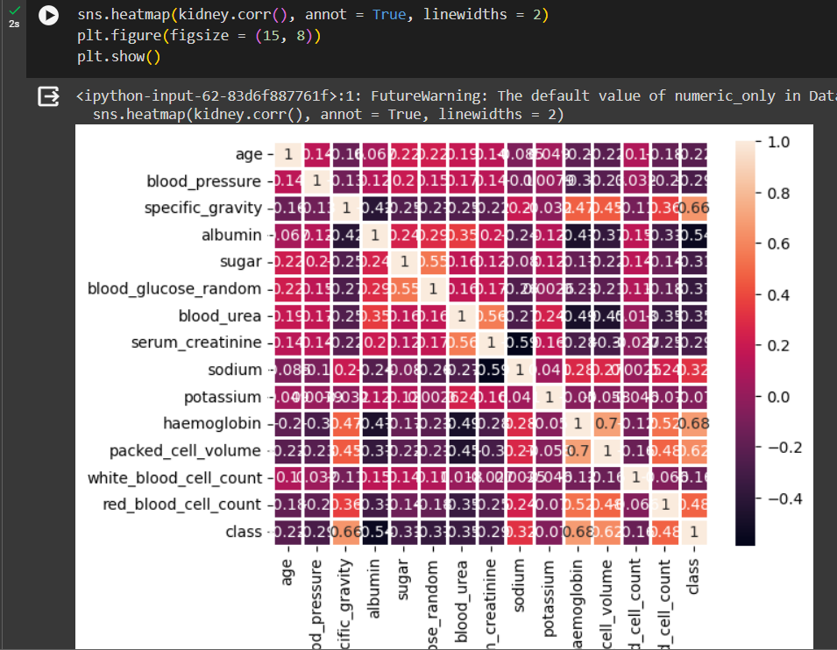
Exploratory Data Analysis

Slide 26
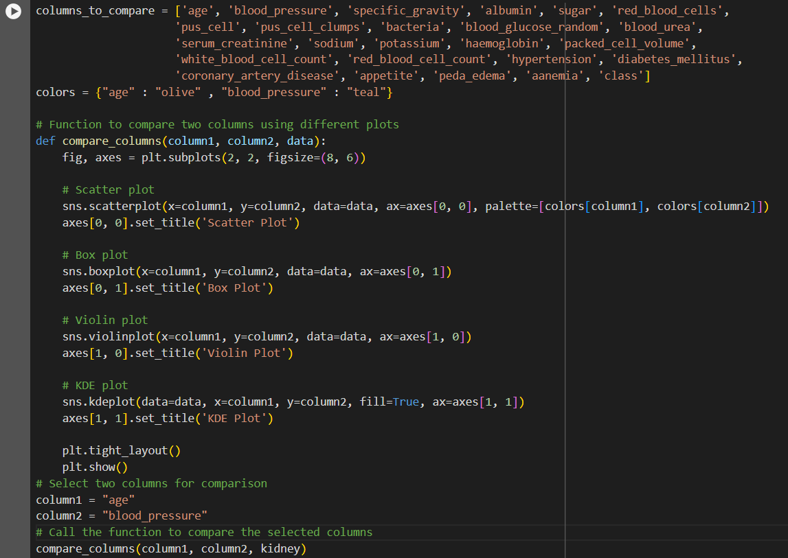
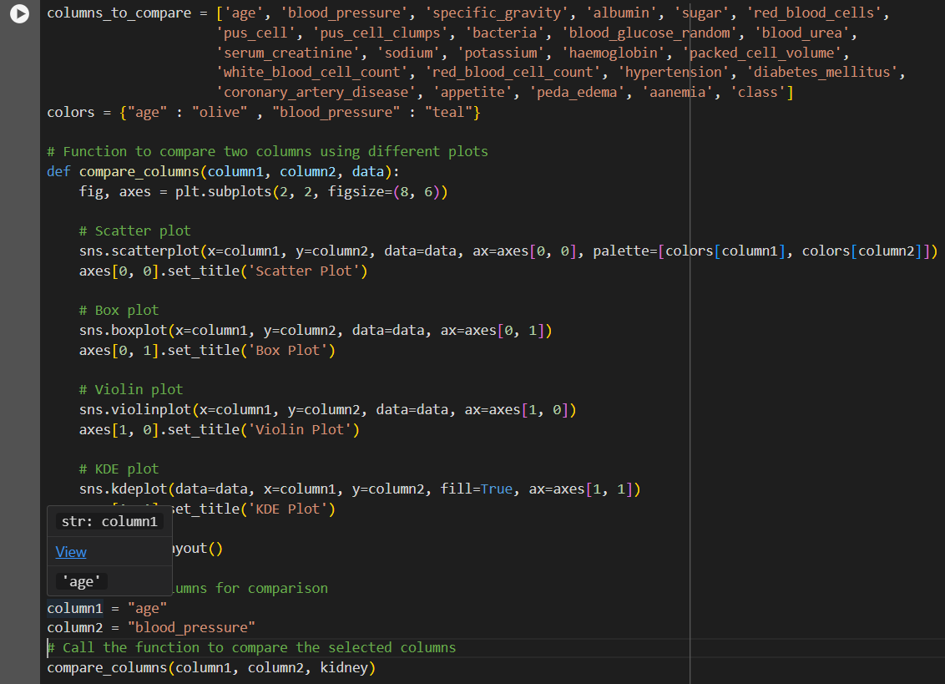
Exploratory Data Analysis

Slide 27
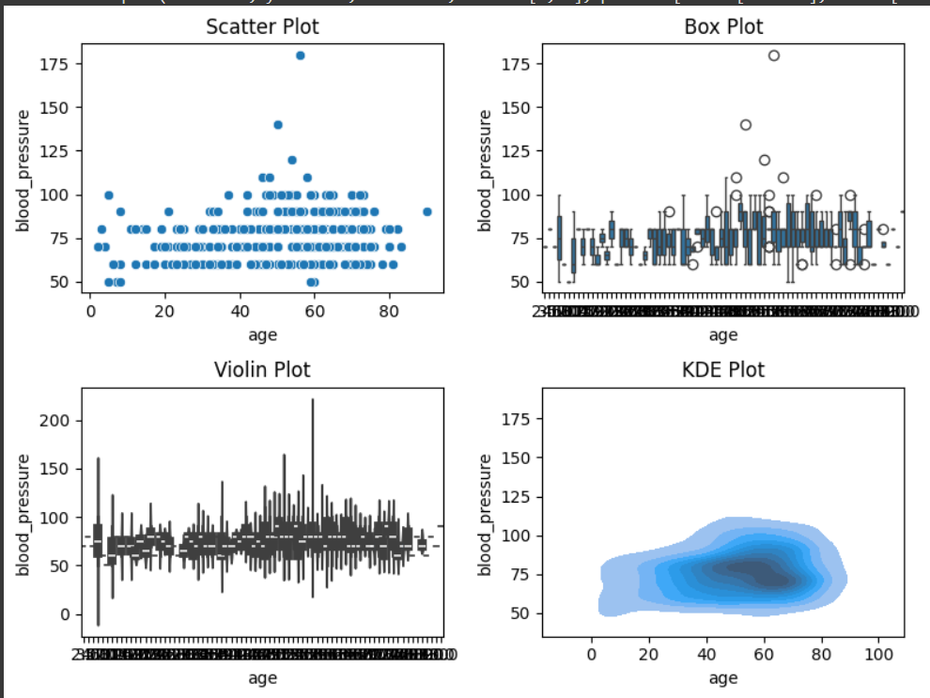
Exploratory Data Analysis

Slide 28
Next Step of Research Focus
Feature Selection and Engineering: Identify the most relevant features for prediction and potentially create new features to enhance model performance.
Model Selection and Evaluation: Explore various machine learning algorithms (e.g., logistic regression, random forests, neural networks) to determine the most suitable models for predicting kidney disease. Evaluate model performance using appropriate metrics (e.g., accuracy, sensitivity, specificity) through cross-validation.
Hyperparameter Tuning: Optimize model performance by fine-tuning hyperparameters using techniques such as grid search or randomized search.
Validation and External Validation: Validate the predictive models on independent datasets to assess generalization performance and ensure robustness. External validation on datasets from different populations or settings can further validate the model's applicability.

Slide 29
Conclusion
In conclusion, the development and application of predictive models for kidney disease offer promising avenues for improving healthcare outcomes.
By leveraging machine learning algorithms and patient data, early detection and intervention strategies can be implemented, leading to better patient care and management.
Ultimately, the integration of predictive analytics holds the potential to significantly impact kidney disease diagnosis, treatment, and patient prognosis, contributing to a healthier population overall.

Slide 30
References :
1. Chittora Pankaj, Sandeep Chaurasia, Prasun Chakrabarti, Gaurav Kumawat, Tulika Chakrabarti, Zbigniew Leonowicz, Michal Jasiński et al., "Prediction of chronic kidney disease-a machine learning perspective", IEEE Access, vol. 9, pp. 17312-17334, 2021.
2. Tangri Navdeep, Lesley A. Stevens, John Griffith, Hocine Tighiouart, Ognjenka Djurdjev, David Naimark, et al., "A predictive model for progression of chronic kidney disease to kidney failure", Jama, vol. 305, no. 15, pp. 1553-1559, 2011.
3.Aqlan Faisal, Ryan Markle and Abdulrahman Shamsan, "Data mining for chronic kidney disease prediction", IIE Annual Conference. Proceedings, pp. 1789-1794, 2017.

Slide 31
References :
4. Dibaba Adeba Debal and Tilahun Melak Sitote, "Chronic kidney disease prediction using machine learning techniques", Journal of Big Data, vol. 9, no. 1, pp. 1-19, 2022.
5. S. R. Burri, A. Kumar, A. Baliyan and T. A. Kumar, "Transforming Payment Processes: A Discussion of AI-Enabled Routing Optimization", 2023 2nd International Conference on Smart Technologies and Systems for Next Generation Computing (ICSTSN) Villupuram India, pp. 1-7, 2023.
6. S. R. Burri, S. Ahuja, A. Kumar and A. Baliyan, "Exploring the Effectiveness of Optimized Convolutional Neural Network in Transfer Learning for Image Classification: A Practical Approach", 2023 International Conference on Advancement in Computation & Computer Technologies (InCACCT), pp. 598-602, 2023.

Slide 32
References :
7. Guneet Kaur, "Predict Chronic Kidney Disease using Data Mining in Hadoop", International Conference on Inventive Computing and Informatics, 2017.
8. Siddeshwar Tekale, "Prediction of Chronic Kidney Disease Using Machine Learning", International Journal of Advanced Research in Computer and Communication Engineering, 2018.
9. Baisakhi Chakraborty, "Development of Chronic Kidney Disease Prediction Using Machine Learning", International Conference on Intelligent Data Communication Technologies, 2019.

Slide 33
References :
10. J. Snegha, "Chronic Kidney Disease Prediction using Data Mining", International Conference on Emerging Trends, 2020.

